Slide 1
INVESTMENT ASSIGNMENT SUBMISSION
Name: Shubham Verma

Slide 2
Investment Analysis: Spark Funds
Spark Funds is an asset management company and wants to make investments in a few companies. The CEO of Spark Funds wants to understand the global trends in investments so that she can take the investment decisions effectively.
The objective is to identify the best sectors, countries, and a suitable investment type for making investments by analysing the previous investment data trends.
Objectives:
Identify the best sectors, countries, and a suitable investment type for making investments based on the constraints.
Constraints:
Invest between 5 to 15 million USD per round of investment.
Invest only in English-speaking countries because of the ease of communication with the companies.

Slide 3
Problem solving methodology
Business Objective and Problem Statement Understanding
Get below Datasets:
Company Details
Funding round
Sector Classification
Merge and Clean the obtained Data
Getting top 3 countries from resulting data
Country Analysis: Finding top 3 countries with ‘English’ as official language having most investments
Funding Type Analysis: Finding funds with top investments
Plotting required Graphs
Country Analysis: Finding countries with maximum investments
Sector Analysis: Identifying main sectors with above results
End Result
Filtering out countries with ‘English’ as official language

Slide 4
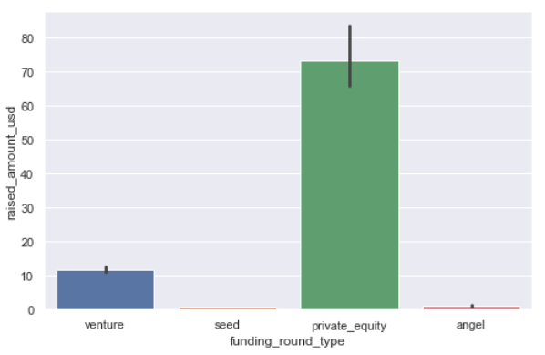
Funding Type Analysis
We want to choose one of these four investment types for each potential investment they will make and wants to invest between 5 to 15 million USD per investment round.
When calculated, ‘Private Equity’ has highest investments with average amount between 70-80 million.
‘Venture’ is the only funding type with average investments in between 5 and 15 million dollars.

Slide 5
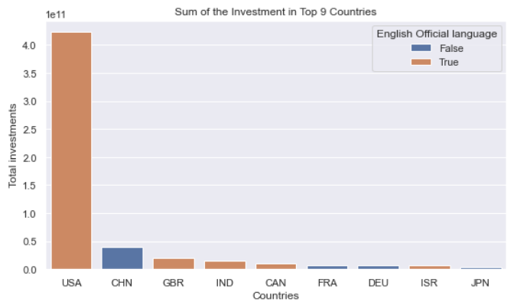
Country Analysis
We want to invest in countries with the highest amount of funding for the calculated investment type.
Additionally these are the top nine countries which have received the highest total funding (across ALL sectors for the chosen investment type) with countries marked where “English” is official language.
We can observe that top 3 countries are: ‘USA’, ‘GBR’ and ’IND’ with top investments in all 3 sectors and ‘English’ as official language.

Slide 6
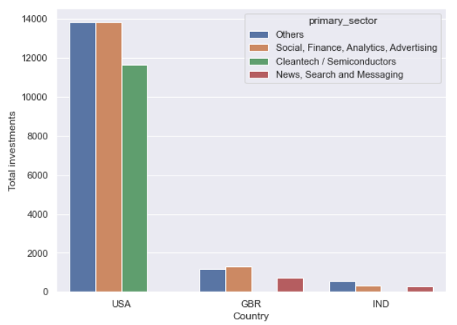
Sector Analysis
The investment data of top 3 countries identified in previous analysis is processed to find out the top sectors in which investments are highest.
Identified Primary Sectors after processing:
Social, Finance, Analytics, Advertising
Others
Cleantech, Semiconductors
News, Search and Messaging
All the above written sectors have investments between 5 and 15 million dollars.

Slide 7
Results
Spark Funds should consider investing in ’USA’ as highest investments are there. Further, they can divide their transactions in different sectors in ‘USA’ to minimize their investment risks.
They should also consider to divide their investments in top 3 countries: USA, United Kingdom and India, to minimize loss from country financial stability.
Top Primary sectors they can consider for investments are:
Social, Finance, Analytics, Advertising
Others
Cleantech, Semiconductors
News, Search and Messaging

